Slide 1
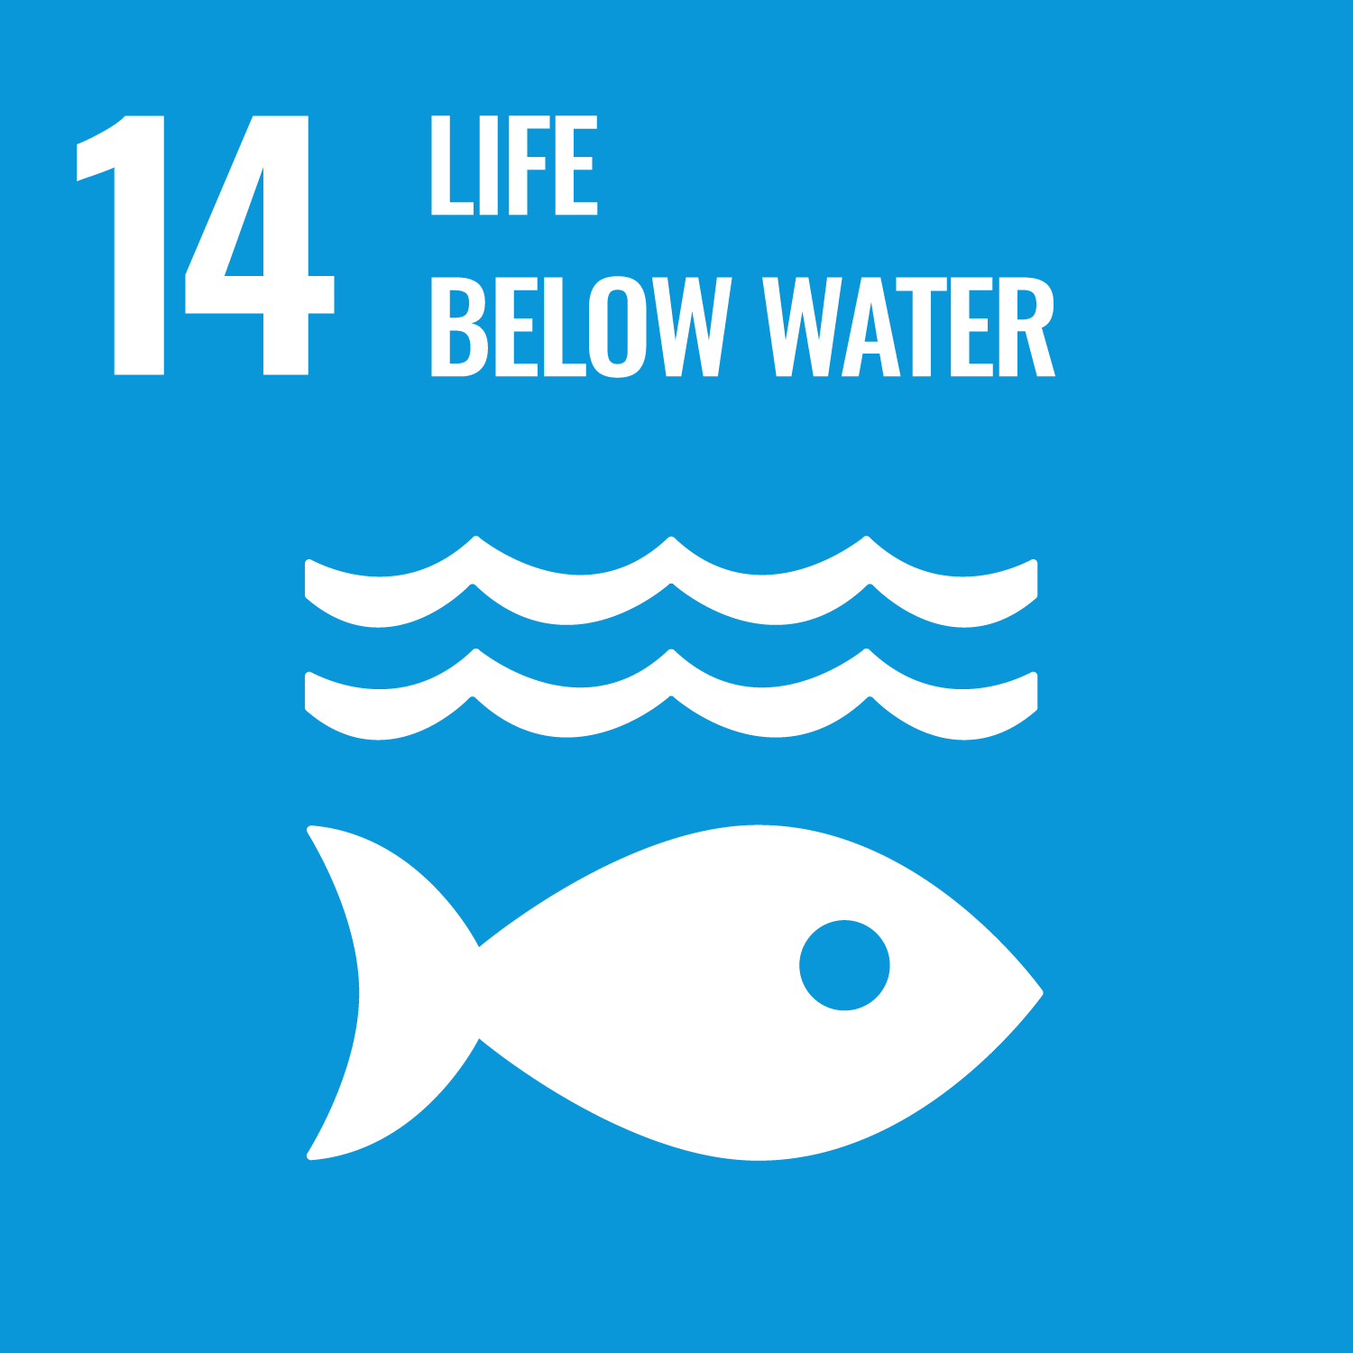
Change by Pocean
environmental sunscreen
Safe Ocean SUN CREAM

Slide 2
Brand introduction
MISSION
Give back the sea to marine life
BUSINESS
Pacific ocean
Sustainable Cosmetics Brands

Slide 3
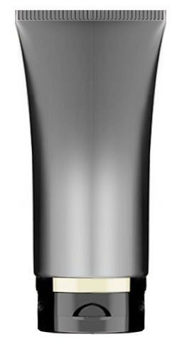
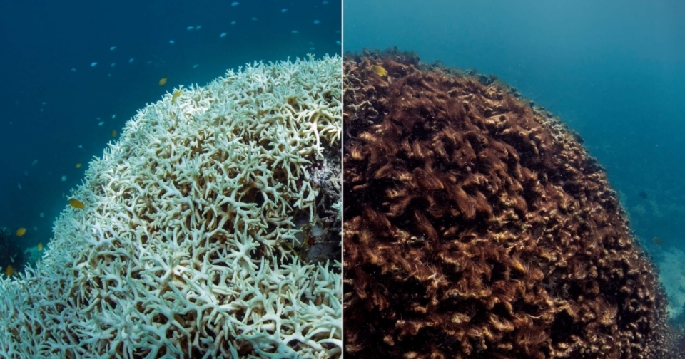
product descriptions
Cosmetics Threatening the Sea
Microplastics
Nylon, PE, PP, PET, PMMA, Acrylic, 등
hormonal disturbance
Dioxin, triclosan, Paraben, alkylphenols 등
Cosmetic product
Other destruction of marine
adverse effects of marine
Sunscreen is the main culprit of coral destruction
SUN
Cream
Hawaii
Palau
Thailand
ABC Islands
‘SUNSCREEN STOP’

Slide 4
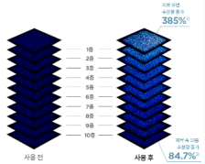
SOS product descriptions
Safe Ocean Sun cream 50ml ▶ $20
[SOS Product Overview]
Strong blocking
UVA Blocking, UVB Blocking, Infrared Blocking, Ultrafine Dust Blocking
20 types of skin-free ingredients, certified vegan, and tested for skin irritation
Oxybenzone-free, oxy-noxate-free sun care for coral relief
Skin safety
Sea Safrty
Wound healing ointment ingredients
Dex Panthenol
Up to 10 layers of skin It helps absorb Elastic liposome
Skin care
Technology
People and the sea Safe Sunscreen

Slide 5
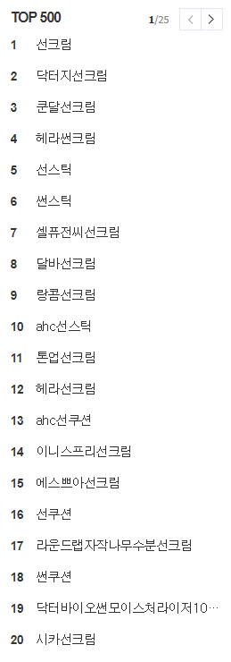
Targets
Suncare Market Rise
Features of MZ generation beauty type utilization
20Y Online Suncare Market Rise 7% Year-on-Year
Care | Hypoallergenic and highly functional skincare
Leave No Dirt | Skin care that starts with cleansing
Eco | The Rise of Sustainable Clean Beauty
All for me | Choose products and brands that meet needs
Natural | complexion/impression-oriented look that brings out the original "me“ a natural shade
<Top Online Channel Sales Brands and Items>
닥터지
애터미
셀퓨전씨
이니스프리
헤라
< Internet Market Search Volume Ranking >
buy in pursuit of value consumption Women in their 20s who prefer high functional, clean beauty products
Inorganic vehicle = safety Cica sun cream = trace care, etc Expect repair effect

Slide 6
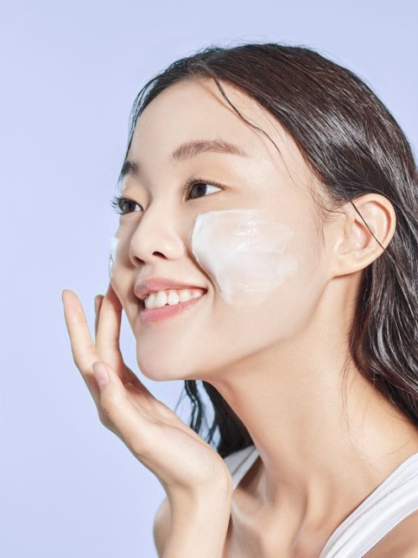
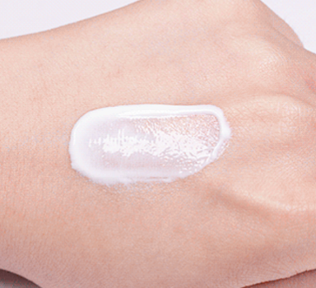
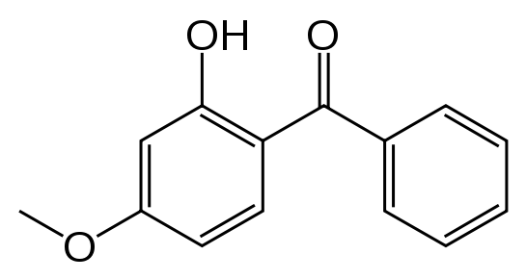
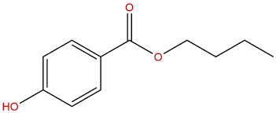
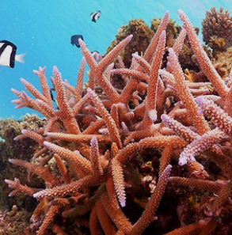
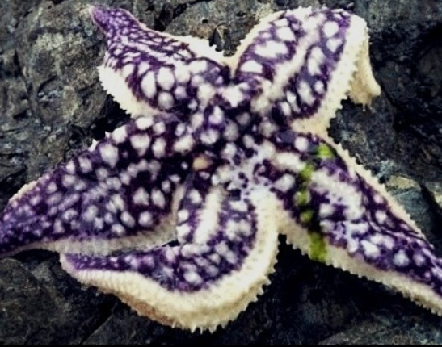
Product Features and Features
Sunscreen demanded by women 20s
For sense of use + safety + eco = SOS
Skincare-like
< formulation >
White color Moisturizing texture
Sunscreen, SPF 50+, PA+++
Moist texture like skin care
Moisturizing to maintain luster and elasticity
Pernicious Ingredients
<ZERO>
Increasing consumer needs for safe products without harmful ingredients
Eliminate harmful ingredients through reconciliation/EWG prescription
Vegan, clean, functional beauty strategies for appeal points
Oxybenzone 4-Methylbenzylden Camper butyl paraben
octinosate
Ocean Safe
< Phenelagen >
protect the sea with materials obtained from the sea
Cosmetics Helps Maintain Marine Ecosystems
destroying the marine
collagen from starfish

Slide 7
LIFE BELOW WATER

